Slide 1

- A Case Study in Operational Improvement by Victoria
As well as solid execution of acquisitions, extraordinary shareholder value has been created by Victoria’s operational excellence. This short case study highlights achievements at UK carpet manufacturer, Abingdon Flooring. Similar operating enhancements are expected to be secured with Balta’s UK carpet business.

Slide 2
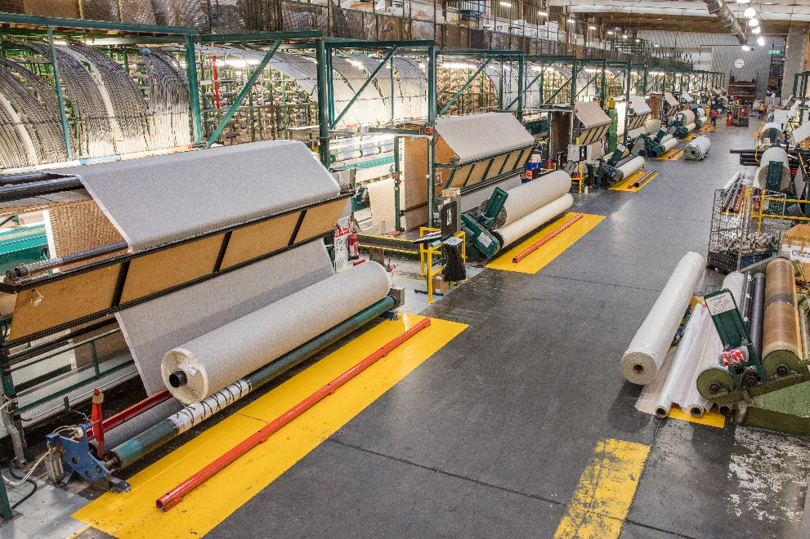
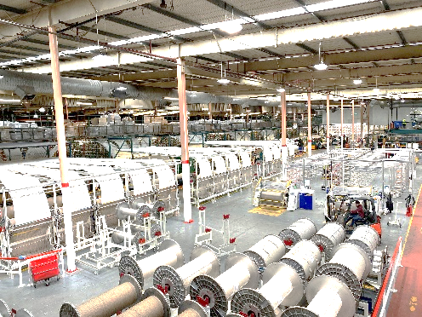
Background
Abingdon Flooring, a UK carpet manufacturer, was acquired by Victoria in September 2014 for £13.4 million (inclusive of earned contingent consideration).
In the two years prior to the acquisition, the Company had revenue of £72.1 and £70.4 million and EBITDA of £1.9 (3.3% margin) and £2.3 million (4.2% margin).
New, high-speed tufting machines increases volume output and productivity
Financial Snapshot At Time of Acquisition
New beaming equipment enables highly efficient short production runs, reducing working capital
1

Slide 3
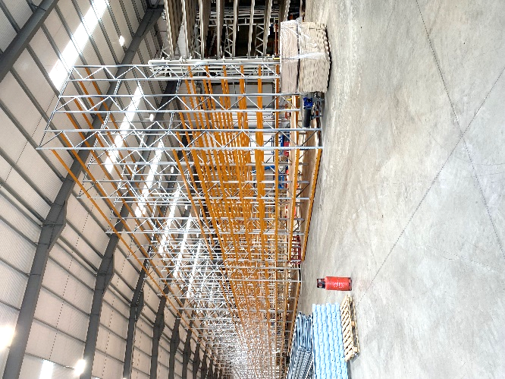
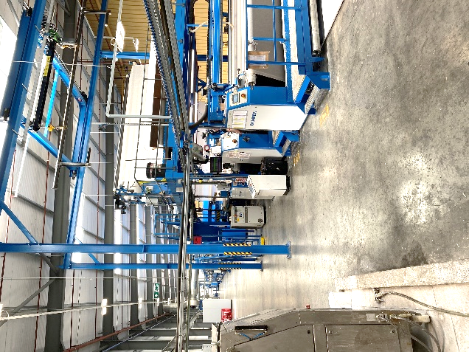
Operational improvements
In 2017/18, Victoria executed a comprehensive plan to improve the throughput, efficiency and quality of Abingdon’s production.
In total, Victoria invested £10.3 million, taking the following actions:
Closure of the Victoria Carpets’ Kidderminster factory and consolidation of production within Abingdon’s factory in Wales.
Offshoring of yarn extrusion to save cost
Replacement of two old finishing lines with one modern, faster finishing line
Addition of new, faster tufting machines
New warehouse to enable an enhanced service proposition (3-day delivery to 91% of U.K.)
Logistics fleet enlarged to 240 vehicles to improve delivery efficiency
New warehouse (in construction)
Victoria’s investments resulted in a 46% increase in production capacity to 22 million metre² per year alongside production cost savings of £0.28 per metre² of carpet produced.
New fast backing line improves quality and output
2

Slide 4
Earnings Impact
Since the improvements made in 2017-2018, Abingdon has increased its annual EBITDA from ~£3.2mm (FY2014) to £13.3mm (FY2021).
Production output has increased 46% to 22 million m² with 150 fewer employees (from c.350 to 200 FTE)
In addition to its reported earnings, Abingdon generates cost savings for other group companies that manufacture in Abingdon’s facility. As of FY2021, Abingdon’s production cost improvements save Victoria an incremental ~£3 million annually.
Victoria spent a total of £23.6mm in the purchase of Abingdon (including subsequent capex). With FY2021 Adj. EBITDA of £13.3mm plus c.£3mm of group savings, the retrospective purchase price is equal to 1.5x EBITDA.
Victoria’s ability to execute dramatic post-transaction operational improvements is the key contributor to Victoria’s track record of generating wealth for its shareholders
3

